Slide 1

AASD 4004
Machine Learning - II
Applied AI Solutions Developer Program

Slide 2
Module 2
Feature Extraction in Text
Vejey Gandyer

Slide 3
Agenda
Feature Extraction in Text
Why Feature Extraction
Bag of Words
TF-IDF
N-Grams
One-hot encoding
Word2Vec *
GloVe *
* Will be seen in detail in DL-1

Slide 4
Feature Extraction
What is it?

Slide 5
Feature Extraction
Document - refers to a single piece of text information. This could be a text message, tweet, email, book, lyrics to a song. This is equivalent to one row or observation.
Corpus - a collection of documents. This would be equivalent to a whole data set of rows/observations.
Token - this is a word, phrase, or symbols derived from a document through the process of tokenization. This will happen behind the scenes so we won’t need to worry too much about it and for our purposes it essentially means a word. For example the document 'How are you’ would have tokens of 'How', 'are', and ‘you'

Slide 6
Feature Extraction
Why

Slide 7
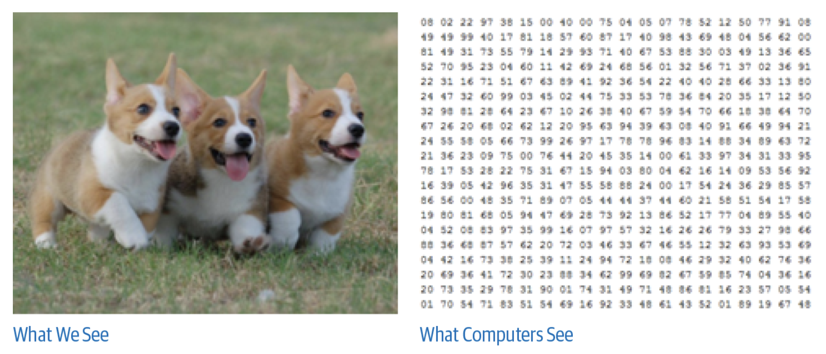
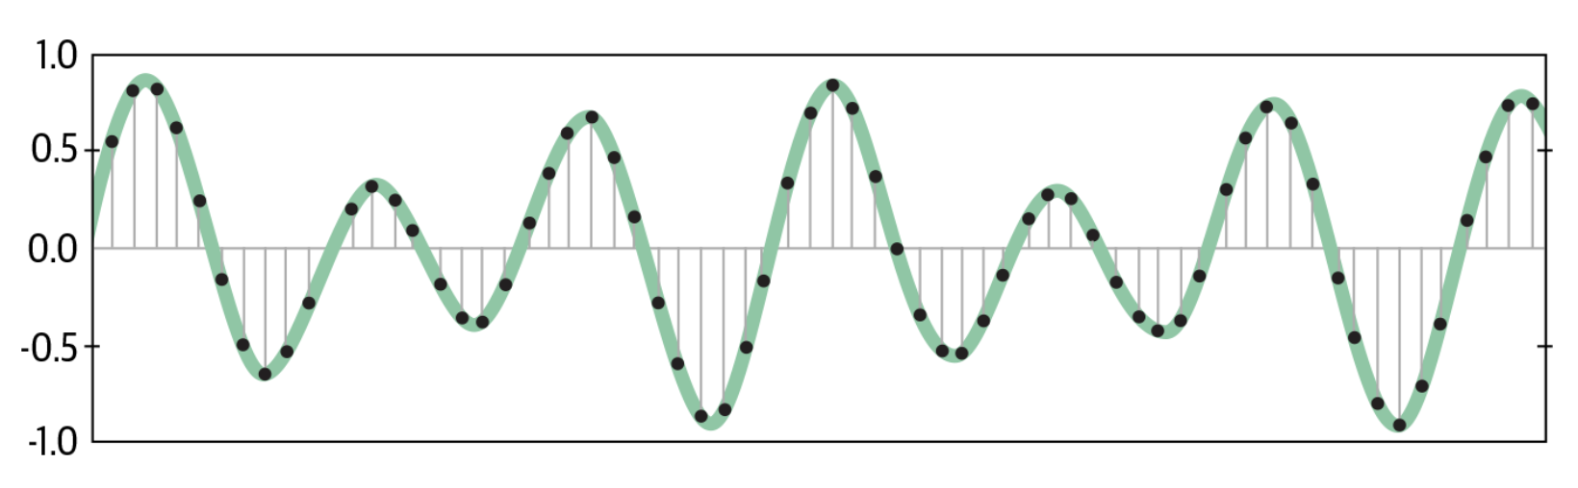
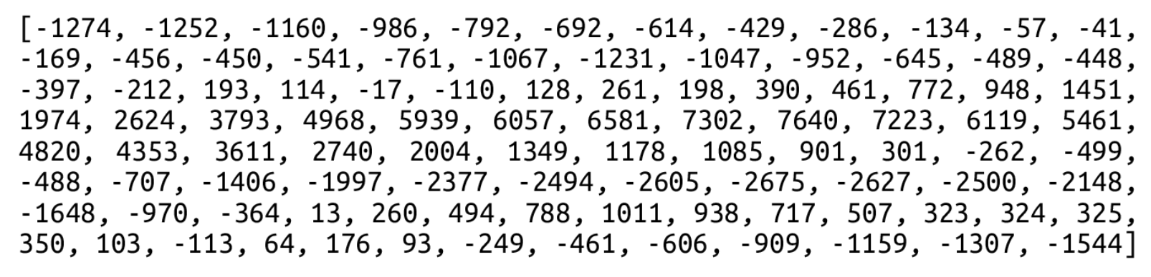
Feature Extraction

Slide 8
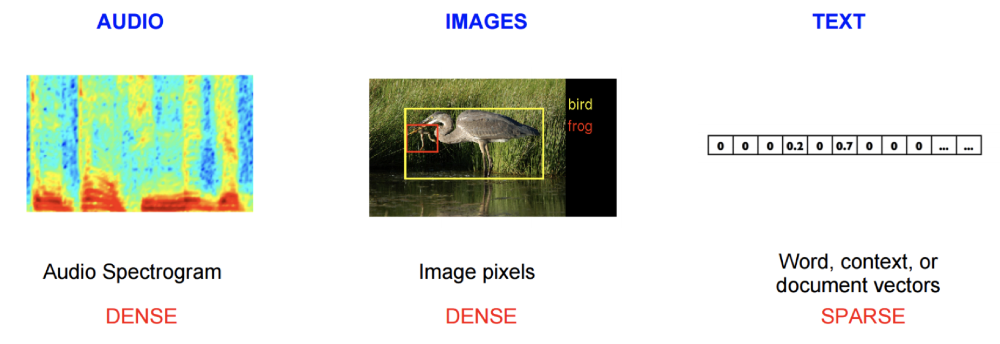
Feature Extraction

Slide 9
Bag of Words

Slide 10
Bag of Words
Suppose we have a corpus with three sentences:
• "I like to play football"
• "Did you go outside to play tennis"
• "John and I play tennis”
Goal: Convert text to numbers

Slide 11
Bag of Words
Tokenize the sentences into words
Create Dictionary of Word Frequency
Bag of Words Model

Slide 12
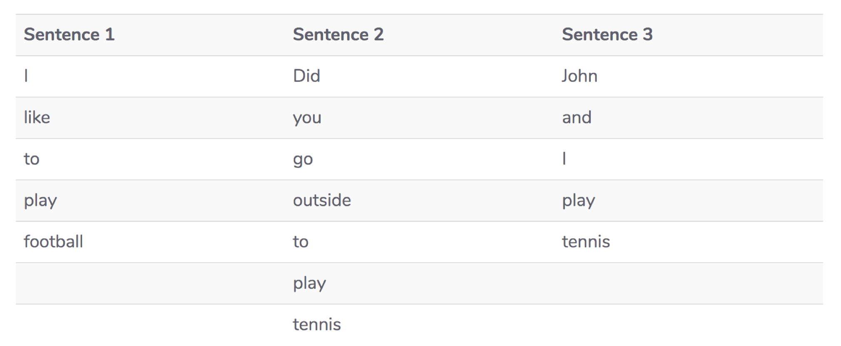
BoW Step 1: Tokenization

Slide 13
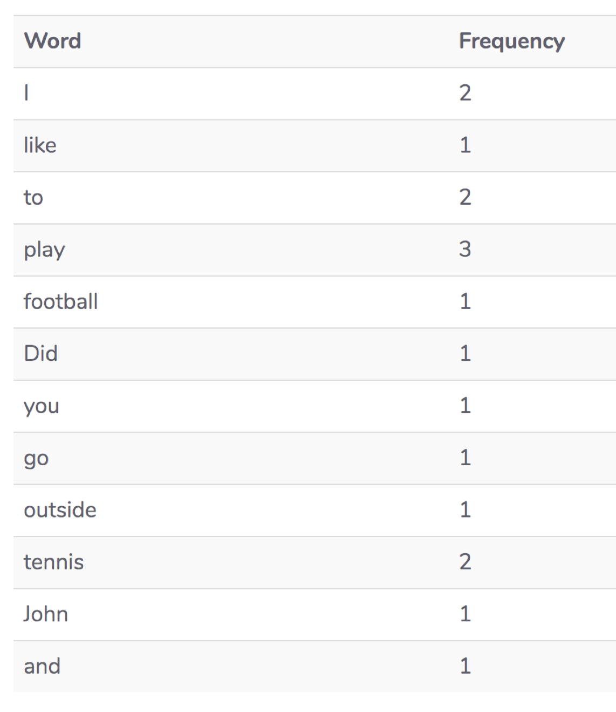
BoW Step 2: Dictionary of Word frequency

Slide 14
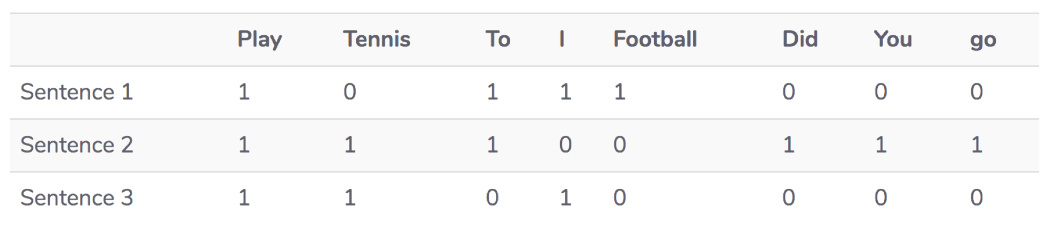
BoW Step 3: Bag of Words Model

Slide 15
Bag of Words
Let’s Create a Bag Of Words Model
BagOfWords.ipynb

Slide 16
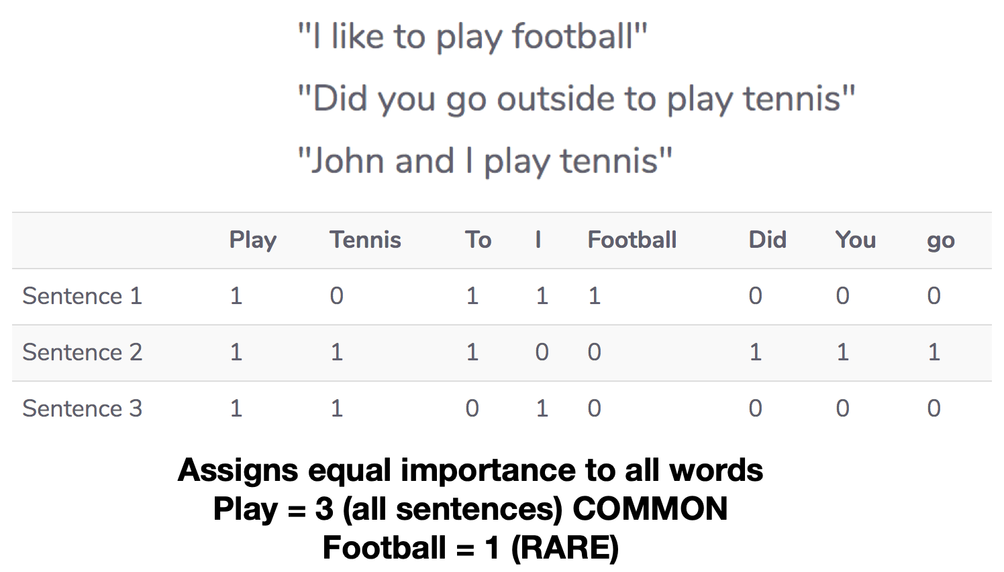
Problems in Bag Of Words

Slide 17
TF-IDF

Slide 18
TF-IDF
Tokenize the sentences into words
Create a Dictionary of word frequency
Sort the dictionary with word frequency
Compute Term frequency
Compute Inverse Document frequency
Compute TF-IDF values

Slide 19
TF-IDF Step 1: Tokenization

Slide 20
TF-IDF Step 2: Dictionary of word frequency

Slide 21
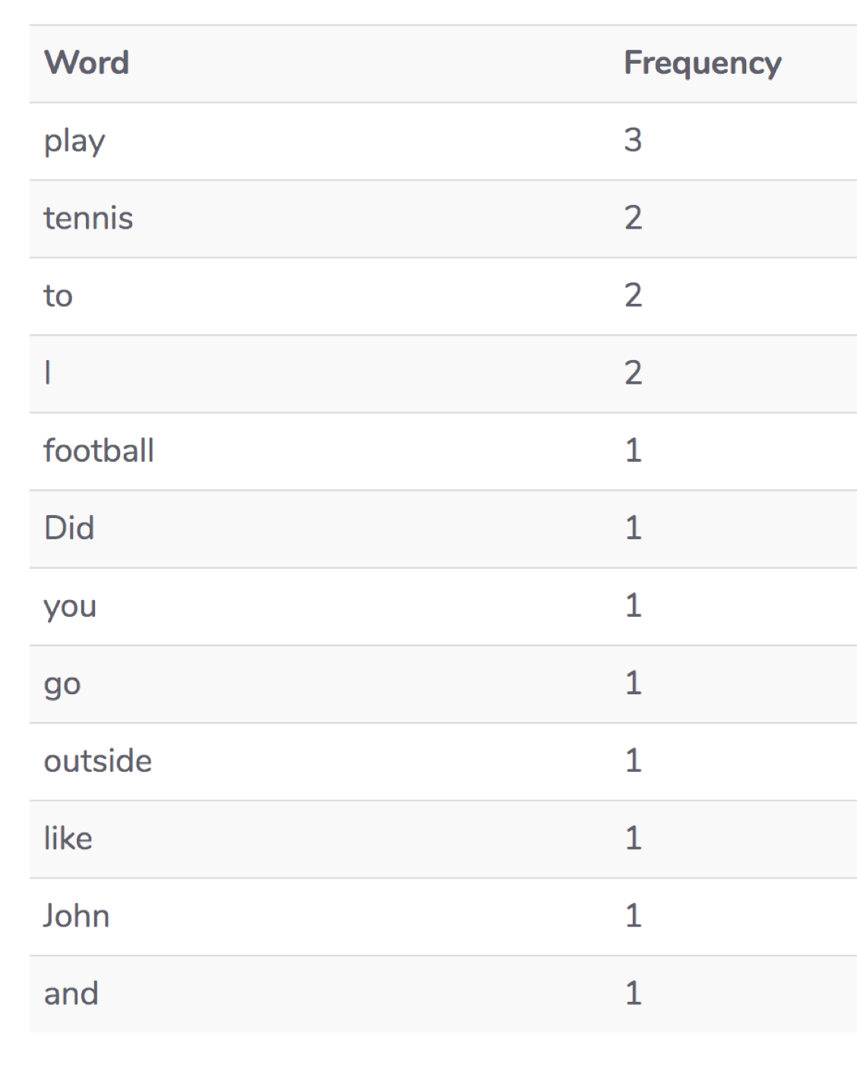
TF-IDF Step 3: Sort word frequency

Slide 22
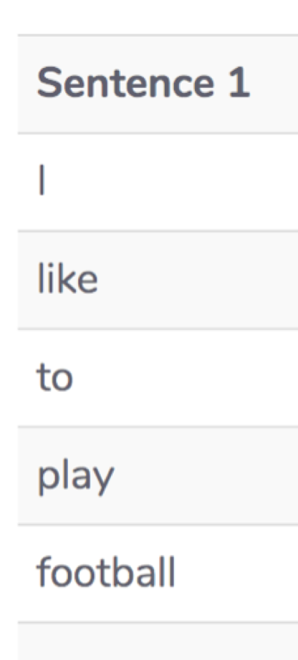
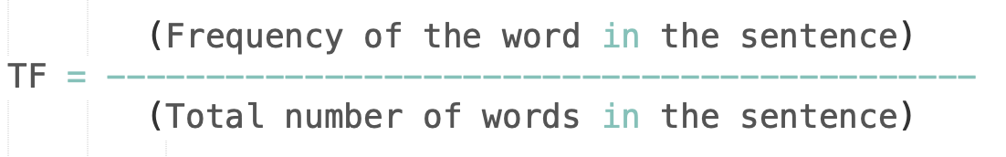
TF-IDF Step 4: Term frequency
play
Term Frequency = 1 / 5 = 0.20
football
Term Frequency = 1 / 5 = 0.20

Slide 23
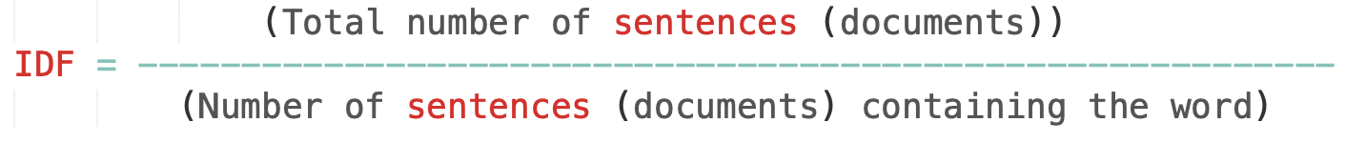
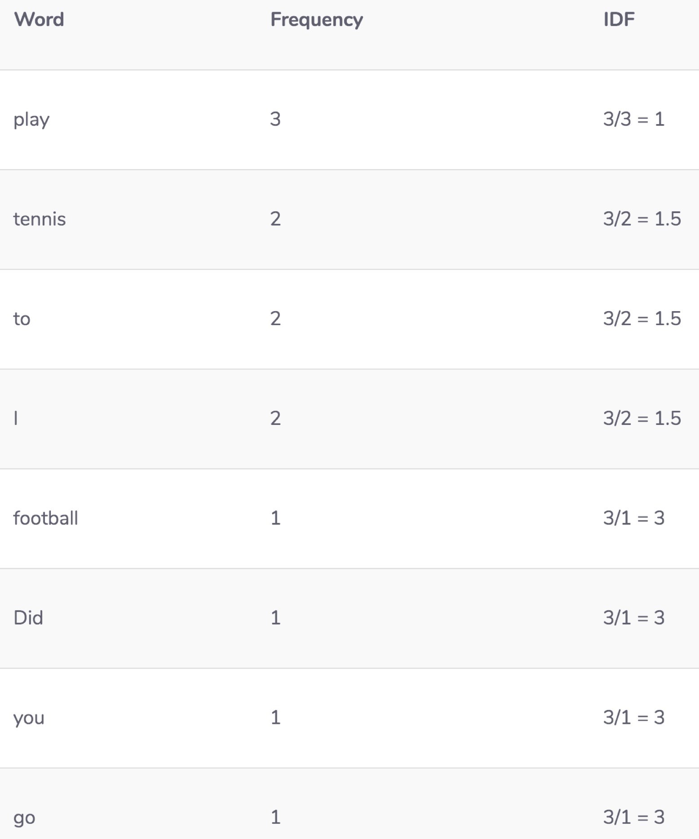
TF-IDF Step 5: Inverse Term frequency

Slide 24
TF-IDF Step 6: TF-IDF Values
TF-IDF = Term Frequency * Inverse Document Frequency
Example: play
Term Frequency = 1 / 5 = 0.20
Inverse Document Frequency = 3 / 3 = 1
TF-IDF = 0.20 * 1 = 0.20

Slide 25
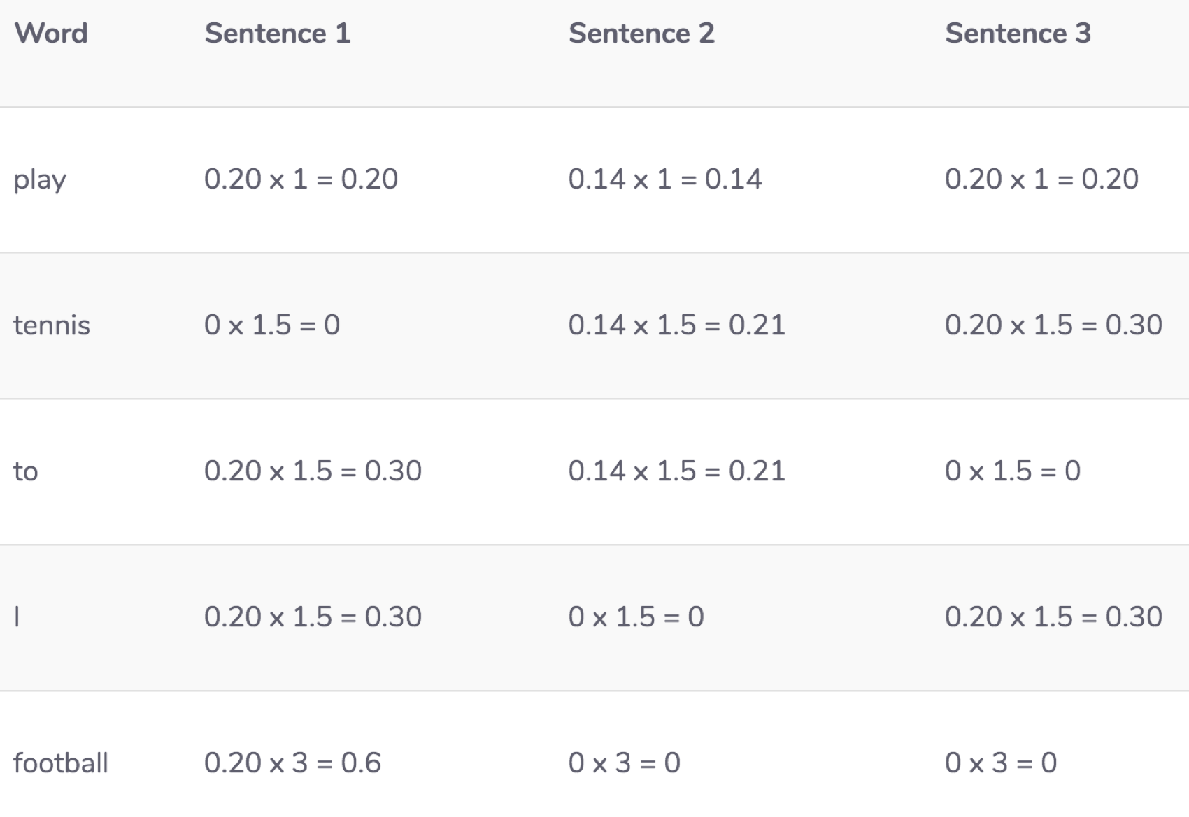
TF-IDF

Slide 26
Problems with TF-IDF
Problems with TF-IDF & BOW
Words are treated individually
No context information is retained
Solution: N-Gram

Slide 27
N-Grams
Character

Slide 28
N-Grams
"A contiguous sequence of N items from a given sample of text or speech"
Markov Chains - sequence of states
Example: 2 states X and Y
In a Markov chain, you can stay at one state or move to another state at any given time XXYX
In an N-Grams model, an item in a sequence can be treated as a Markov state

Slide 29
Character N-Grams
Suppose we have a corpus with one sentence:
“Football is a very famous game”
2-Grams:
fo, oo, ot, tb, ba, al, ll, l , i, is, s , a, v, ve, er, ry, y , f, fa, am, mo, ou, us
3-Grams:
foo, oot, otb, tba, bal, all, ll , l i, is, is , s a, a , a v, ve, ver, ery, …

Slide 30
Character N-Grams Model
Step 1: Import all the necessary libraries
Step 2: Extract the contents of wikipedia article of interest
Step 3: Clean the extracted text
Step 4: Build the N-Grams model
Step 5: Generate sequence

Slide 31
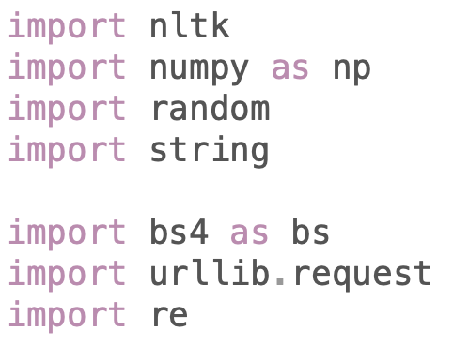
Step 1: Import libraries

Slide 32
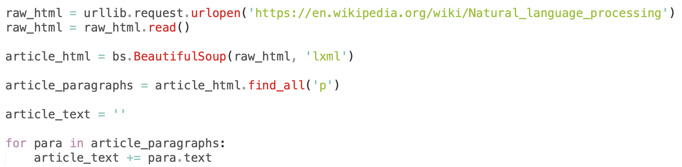
Step 2: Scrape wiki article

Slide 33
Step 3: Clean text

Slide 34
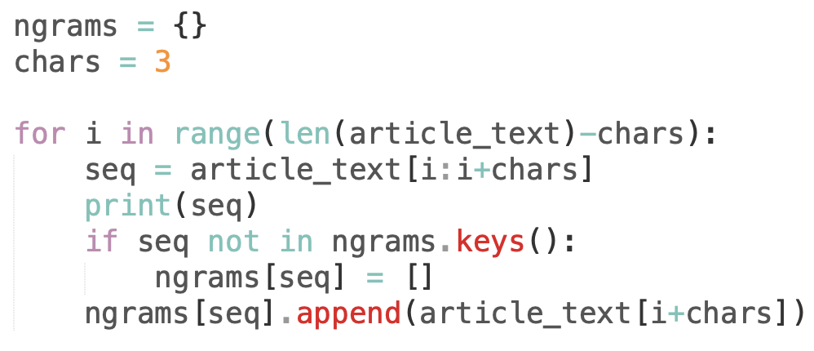
Step 4: N-Grams Model

Slide 35
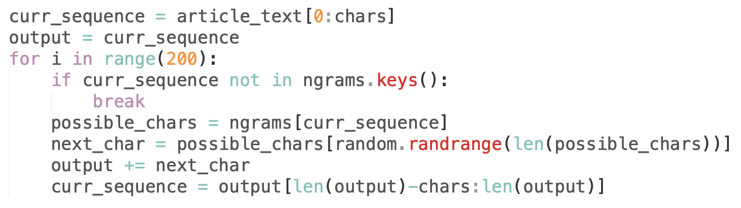
Step 5: Generate Sequence

Slide 36
Character N-Gram Sequence Generator

Slide 37
N-Grams
Word

Slide 38
Word N-Gram
Suppose we have a corpus with three sentences:
• "I like to play football"
• "Did you go outside to play tennis"
• "John and I play tennis”
2-Grams:
I like, like to, to play, play football
Did you, you go, go outside, outside to, to play, play tennis
John and, and I, I play, play tennis
​ ​
3-Grams:​
I like to, like to play, to play football​
Did you go, you go outside, go outside to, outside to play, to play tennis​
John and I, and I play, I play tennis​
​
​

Slide 39
Word N-Grams Model
Step 1: Import all the necessary libraries
Step 2: Extract the contents of wikipedia article of interest
Step 3: Clean the extracted text
Step 4: Build the N-Grams model
Step 5: Generate sequence

Slide 40
Step 1: Import libraries

Slide 41
Step 2: Scrape wiki article

Slide 42
Step 3: Clean text

Slide 43
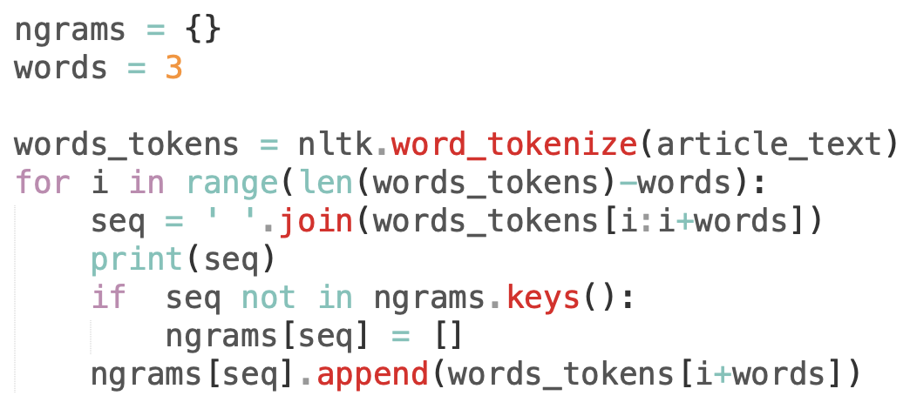
Step 4: N-Grams Model

Slide 44
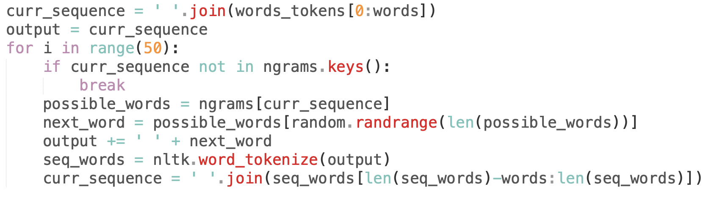
Step 5: Generate Sequence

Slide 45
Word N-Gram Sequence Generator
Character-Gram Generator
Word-Gram Generator

Slide 46
One-hot encoding

Slide 47
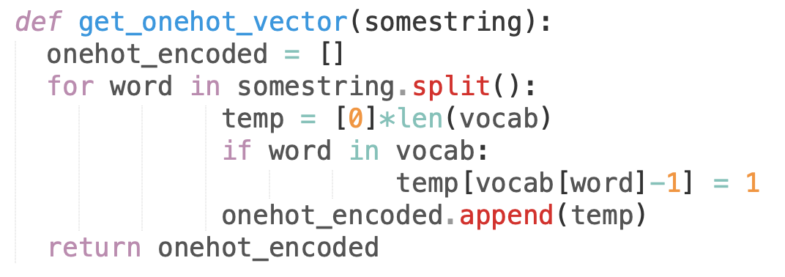
One-hot encoding

Slide 48
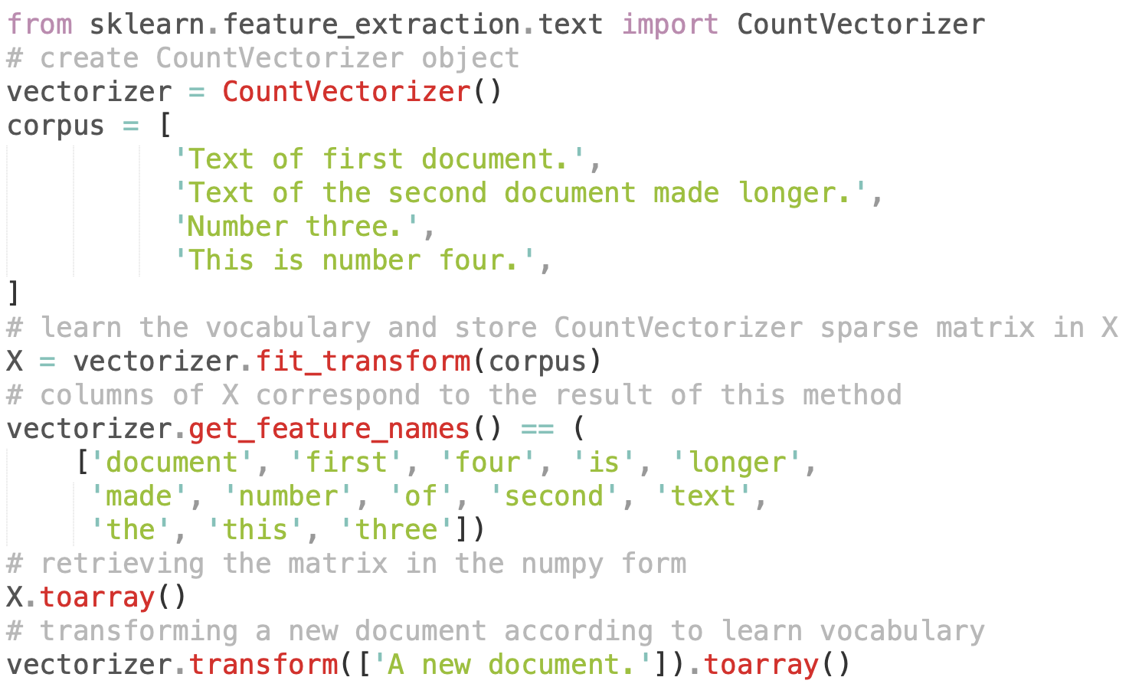
CountVectorizer

Slide 49
Word2Vec

Slide 50
Word2Vec
Words that appear in same context share semantic meaning
1. Count-based method (Latent Semantic Analysis)
Count-based methods compute the statistics of how often some word co-occurs with its neighbour words in a large text corpus, and then map these count-statistics down to a small, dense vector for each word.
2. Predictive method (Neural Probabilistic Language Model)
Predictive models directly try to predict a word from its neighbours in terms of learned small, dense embedding vectors.
Word2Vec —> Predictive Method

Slide 51
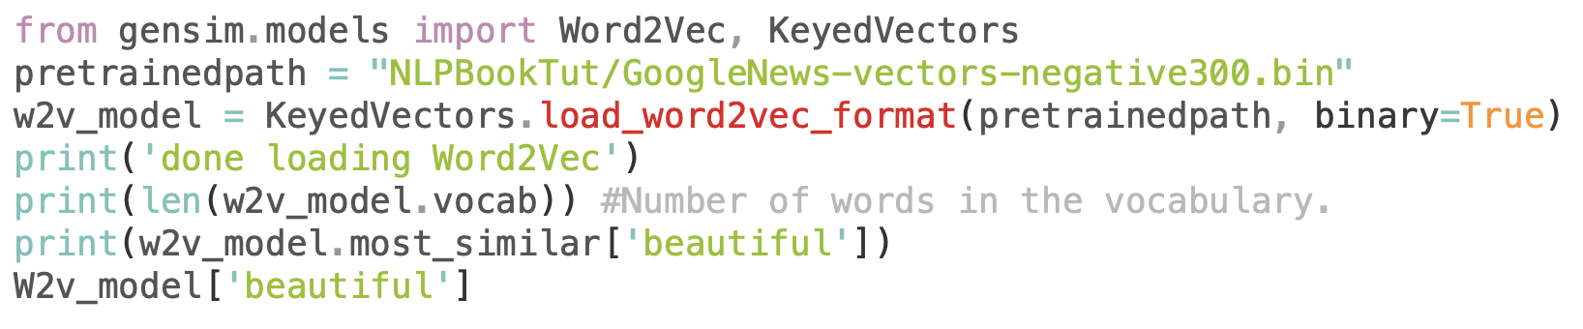
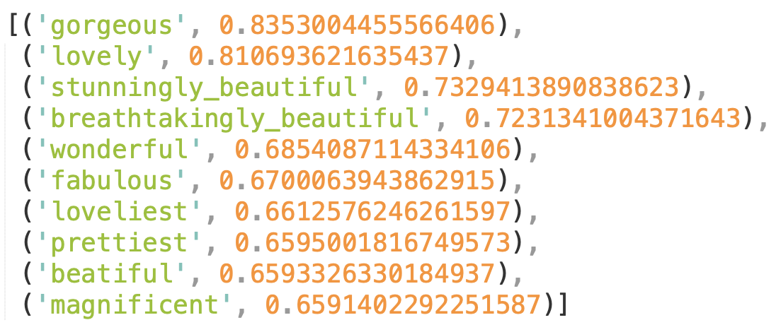
Word2Vec

Slide 52
Word2Vec
Similar words tend to occur together and will have similar context
Eg: – Apple is a fruit. Mango is a fruit.
Apple and mango tend to have a similar context i.e fruit.

Slide 53
Word2Vec
Co-occurrence – For a given corpus, the co-occurrence of a pair of words say w1 and w2 is the number of times they have appeared together in a Context Window.
Context Window – Context window is specified by a number and the direction. So what does a context window of 2 (around) means?

Slide 54
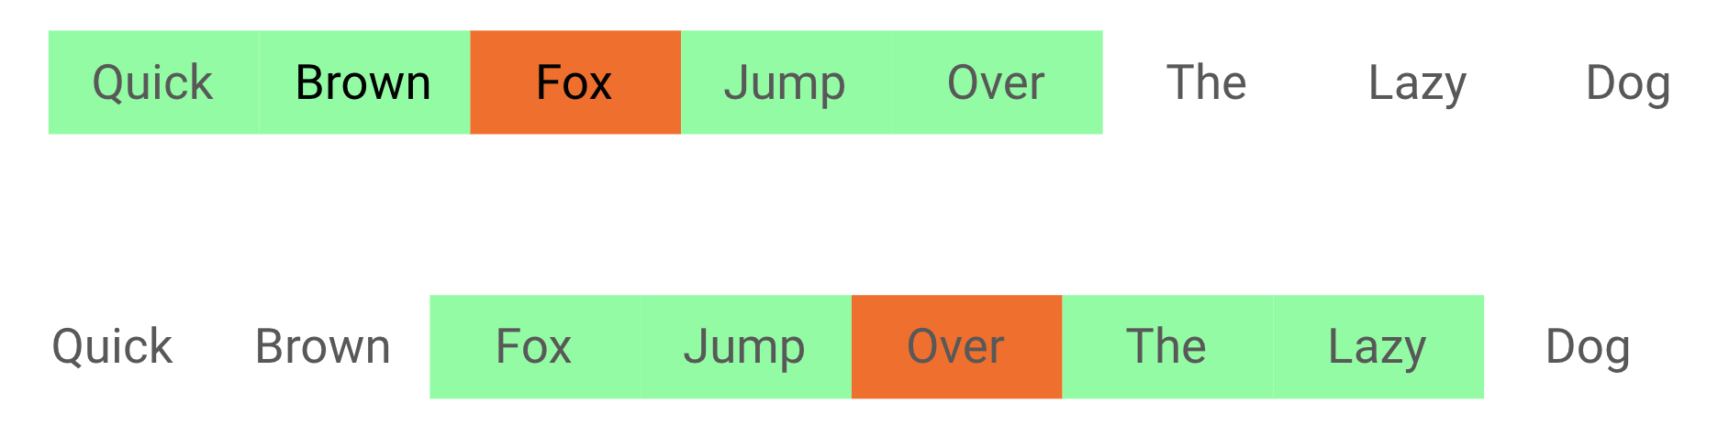
Context Window

Slide 55
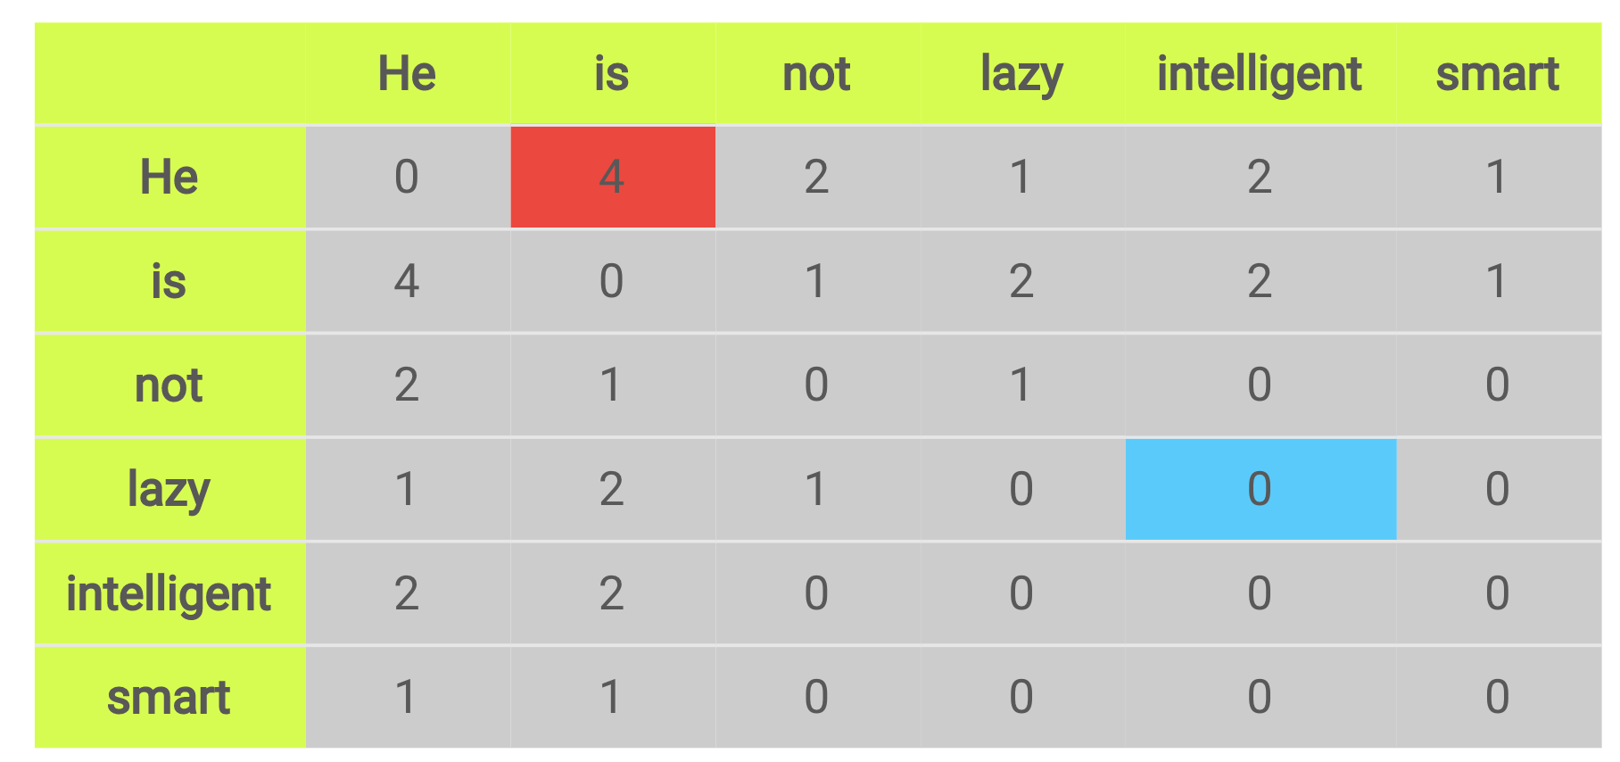
Context Window
Corpus: He is not lazy. He is intelligent. He is smart.

Slide 56
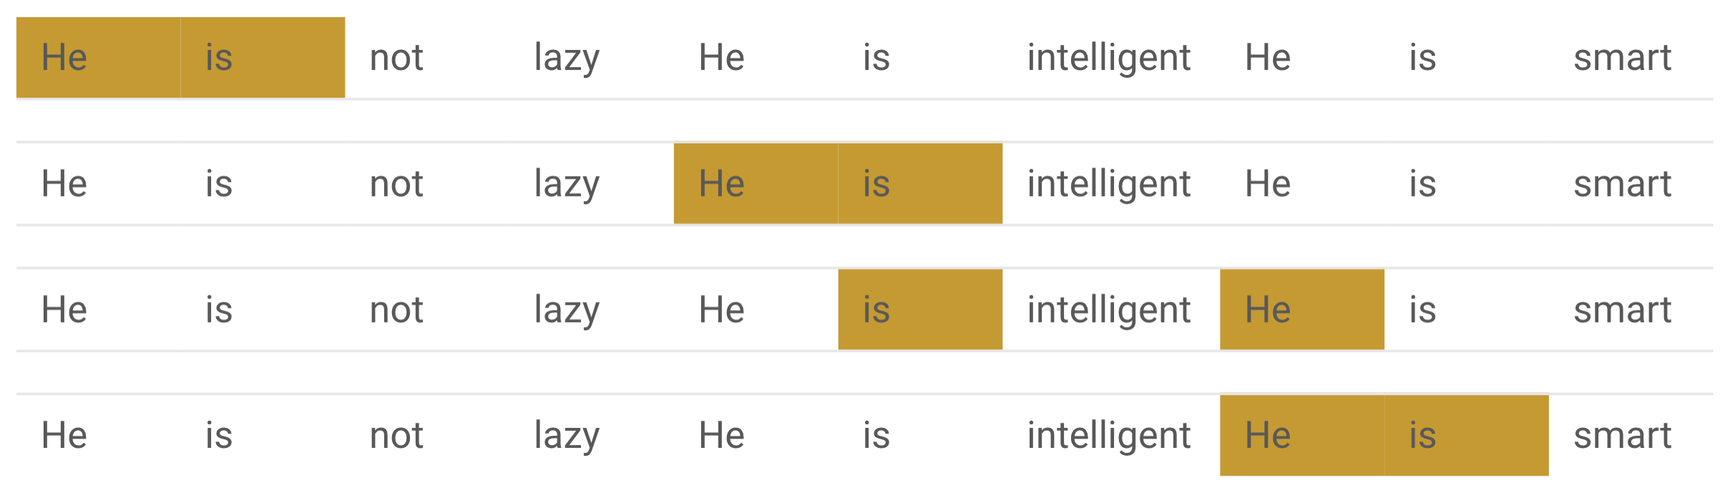
Context Window
Corpus: He is not lazy. He is intelligent. He is smart.

Slide 57
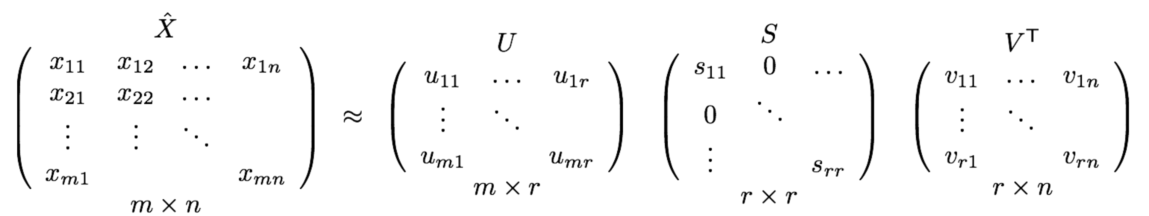
Factorization
Co-occurrence matrix is decomposed using techniques like PCA, SVD etc. into factors and combination of these factors forms the word vector representation.
PCA decomposes Co-Occurrence matrix into three matrices, U,S and V where U and V are both orthogonal matrices. What is of importance is that dot product of U and S gives the word vector representation and V gives the word context representation.

Slide 58
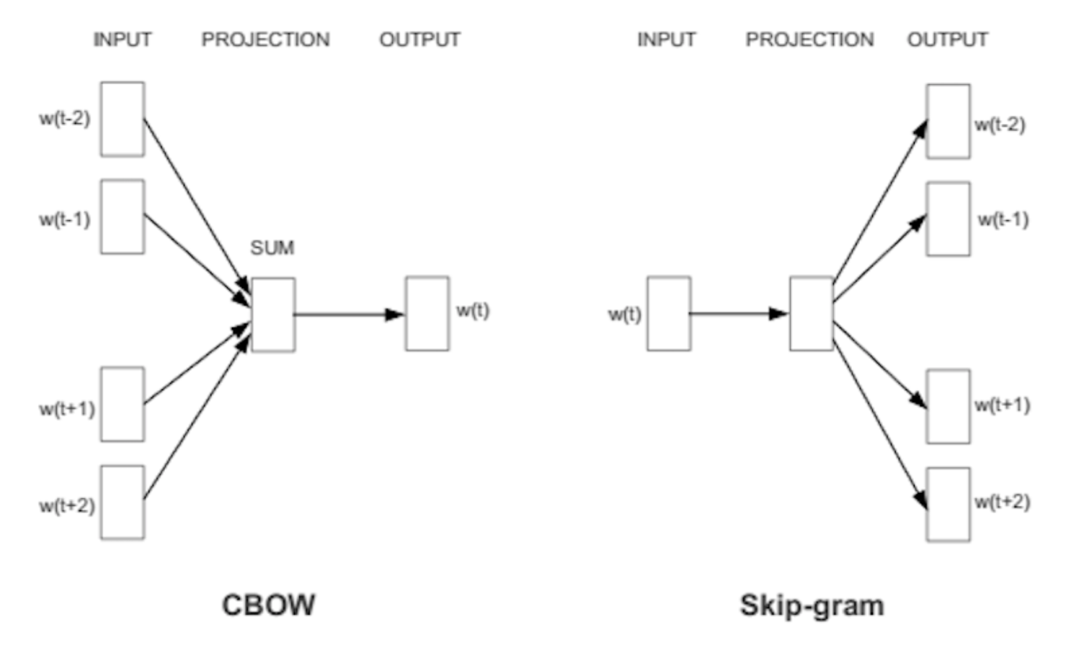
Word2Vec
Word2vec is to group the vectors of similar words together in vectorspace.
Word2vec creates vectors that are distributed numerical representations of word features, features such as the context of individual words.
Word2vec is similar to an autoencoder, encoding each word in a vector, but rather than training against the input words through reconstruction, as a restricted Boltzmann machine does, word2vec trains words against other words that neighbor them in the input corpus.

Slide 59
Word2Vec
CBoW

Slide 60
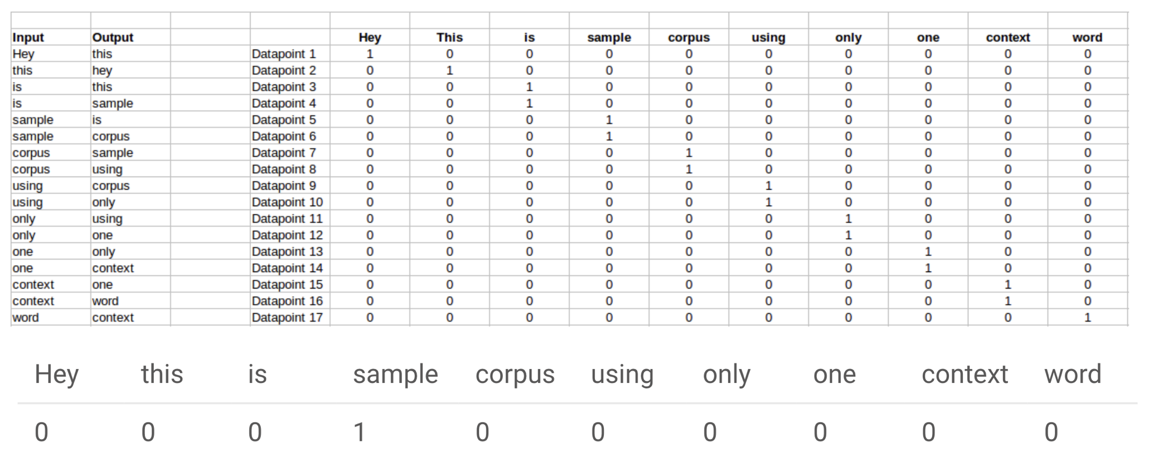
CBoW
Predict Probability of a word given its context
P( word | context )
Corpus = Hey, this is sample corpus using only one context word.

Slide 61
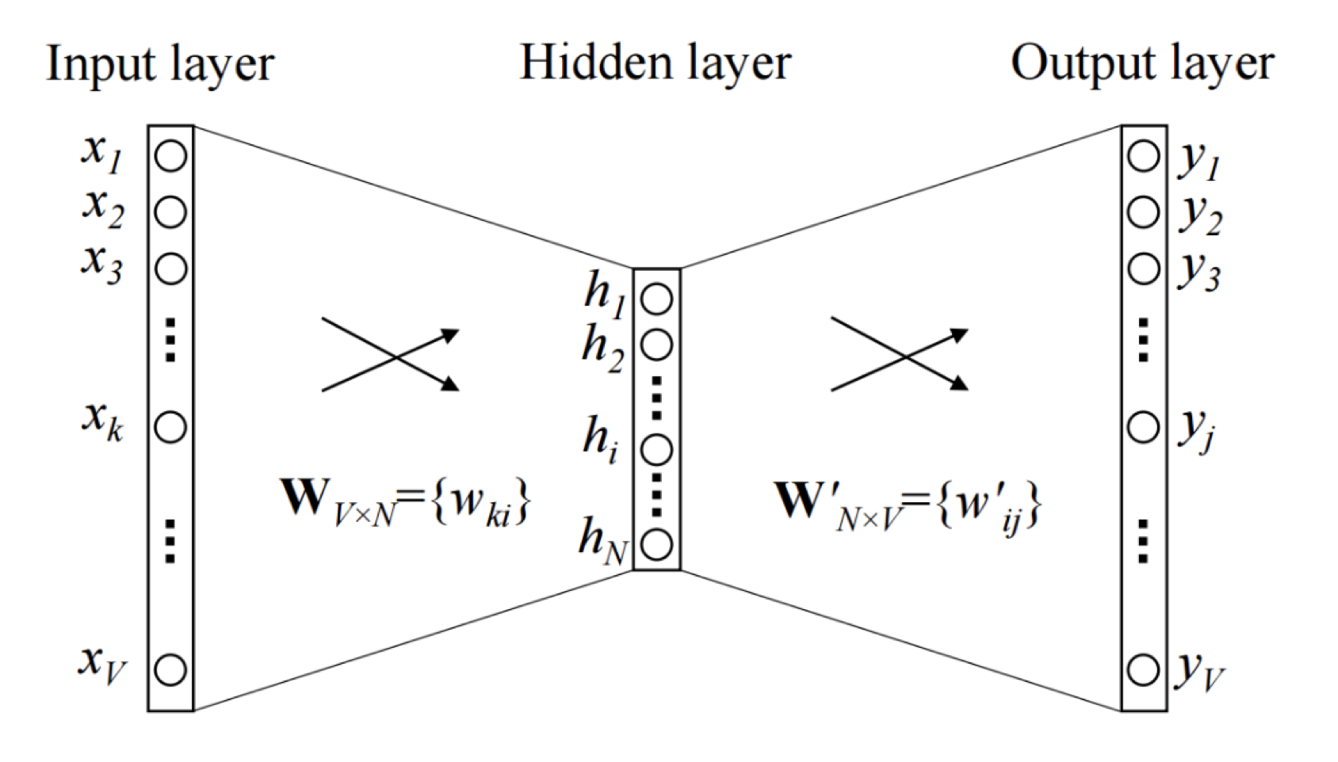
CBoW

Slide 62
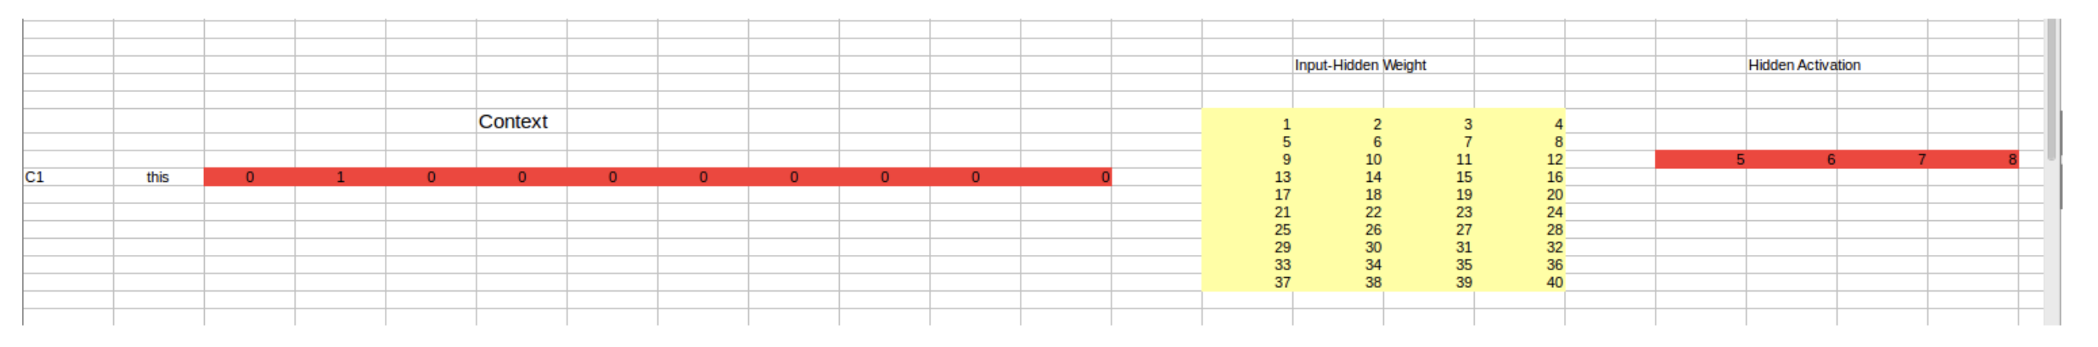
CBoW
1. The input layer and the target, both are one- hot encoded of size [1 X V]. Here V=10
2. There are two sets of weights. one is between the input and the hidden layer and second between hidden and output layer. Input-Hidden layer matrix size =[V X N] , hidden-Output layer matrix size =[N X V] : N is the number of dimensions we choose to represent our word in. It is arbitary and a hyper-parameter for a Neural Network. Also, N is the number of neurons in the hidden layer. Here, N=4.
3. There is a no activation function between any layers.
4. The input is multiplied by the input-hidden weights and called hidden activation. It is simply the corresponding row in the input-hidden matrix copied.
5. The hidden input gets multiplied by hidden- output weights and output is calculated.
6. Error between output and target is calculated and propagated back to re-adjust weights.
7. The weight between the hidden layer and the output layer is taken as the word vector representation of the word.

Slide 63
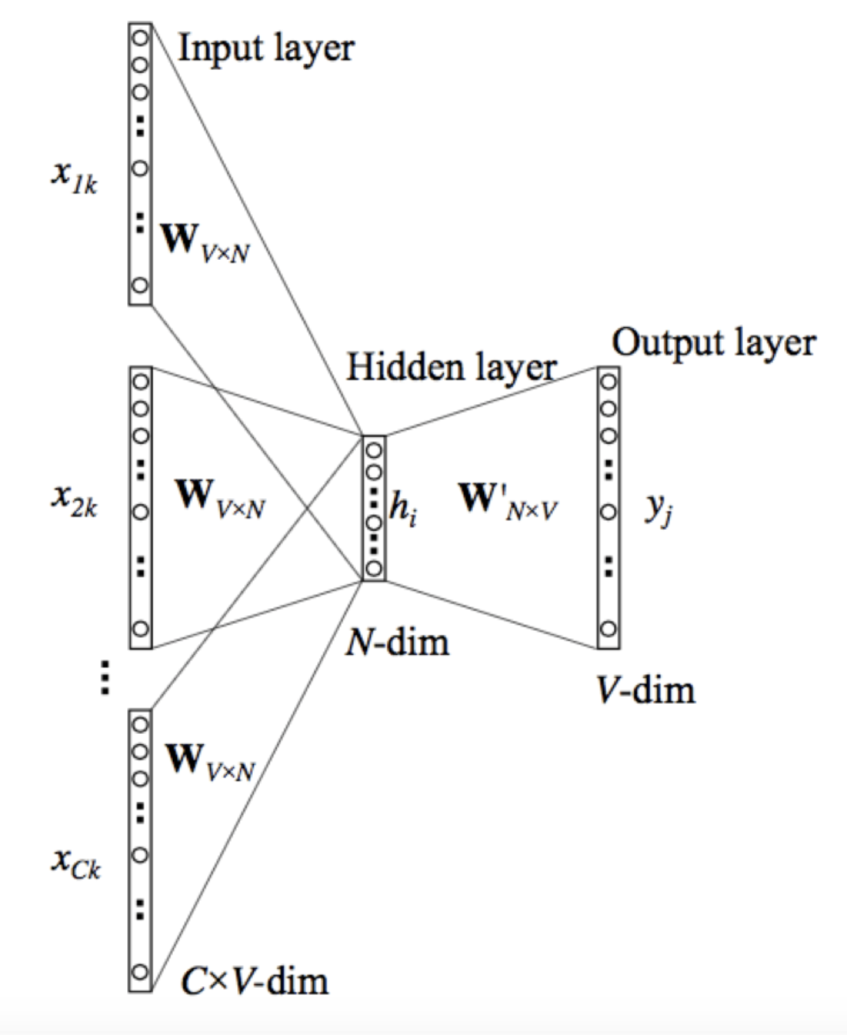
CBoW

Slide 64
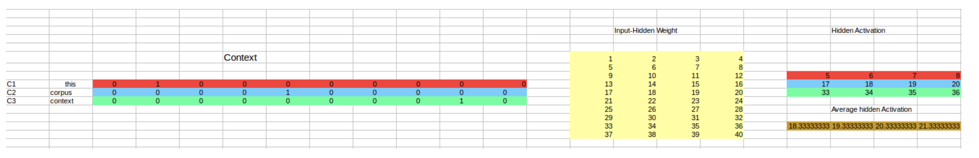
CBoW
So, the input layer will have 3 [1 X V] Vectors in the input as shown above and 1 [1 X V] in the output layer. Rest of the architecture is same as for a 1-context CBOW.
The steps remain the same, only the calculation of hidden activation changes. Instead of just copying the corresponding rows of the input-hidden weight matrix to the hidden layer, an average is taken over all the corresponding rows of the matrix. The average vector calculated becomes the hidden activation. So, if we have three context words for a single target word, we will have three initial hidden activations which are then averaged element-wise to obtain the final activation.

Slide 65
CBoW
Advantages
Being probabilistic is nature, it is supposed to perform superior to deterministic methods.
It is low on memory. It does not need to have huge RAM requirements like that of co-occurrence matrix where it needs to store three huge matrices.
Disadvantages
CBOW takes the average of the context of a word (as seen above in calculation of hidden activation). For example, Apple can be both a fruit and a company but CBOW takes an average of both the contexts and places it in between a cluster for fruits and companies.
Training a CBOW from scratch can take forever if not properly optimized.

Slide 66
Word2Vec
SkipGram

Slide 67
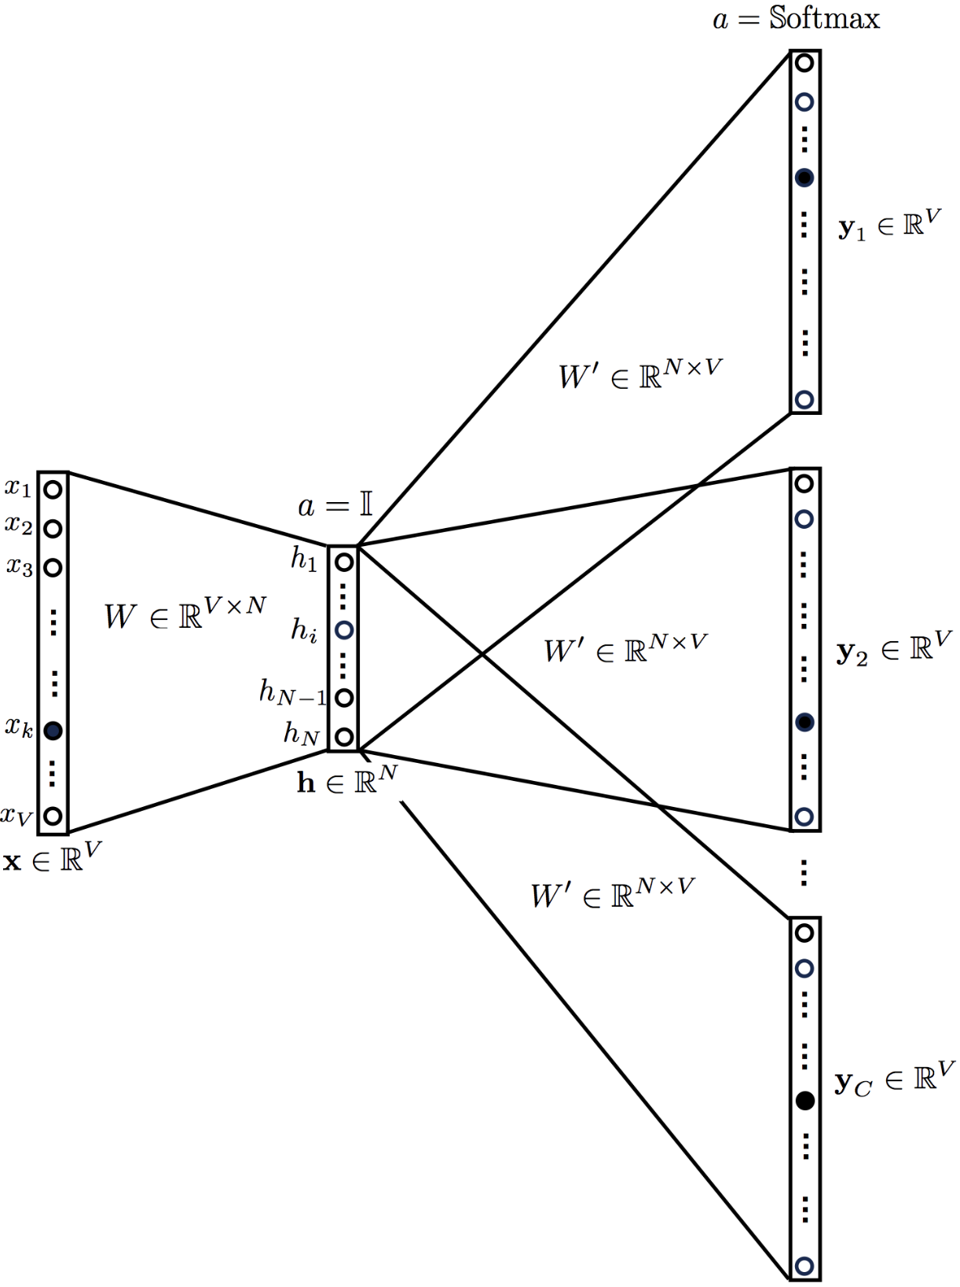
SkipGram
Predicts the context given a word
P( context | word )

Slide 68
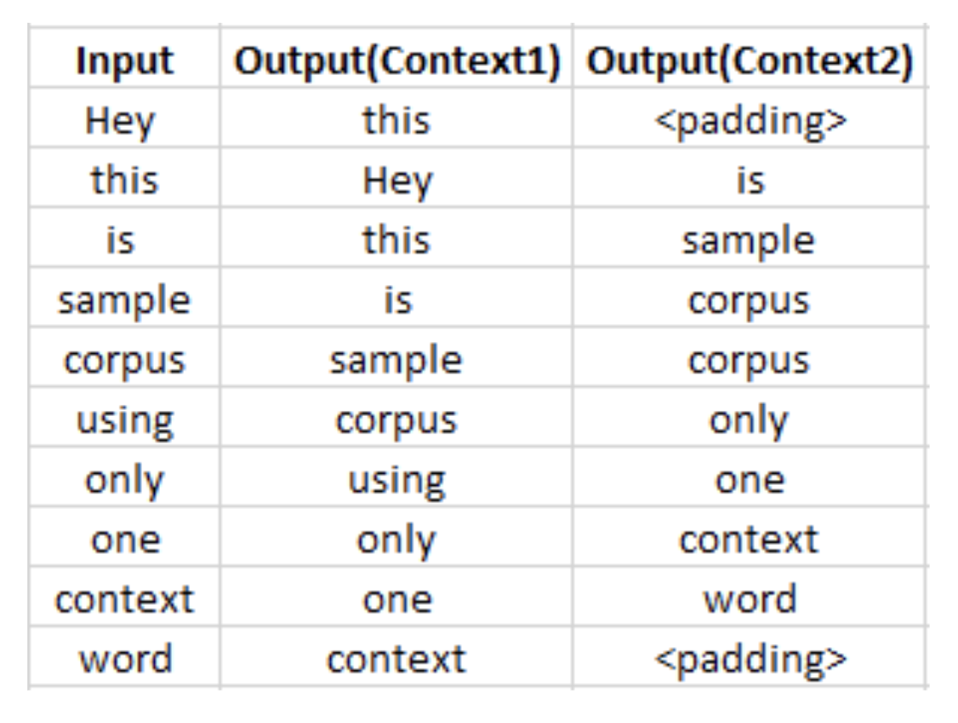
SkipGram
Hey, this is sample corpus using only one context word.

Slide 69
SkipGram
The input vector for skip-gram is going to be similar to a 1-context CBOW model.
The difference will be in the target variable. Since we have defined a context window of 1 on both the sides, there will be “two” one hot encoded target variables and “two” corresponding outputs.
Two separate errors are calculated with respect to the two target variables and the two error vectors obtained are added element-wise to obtain a final error vector which is propagated back to update the weights.
The weights between the input and the hidden layer are taken as the word vector representation after training.
The loss function is of same type as of the CBOW model.

Slide 70
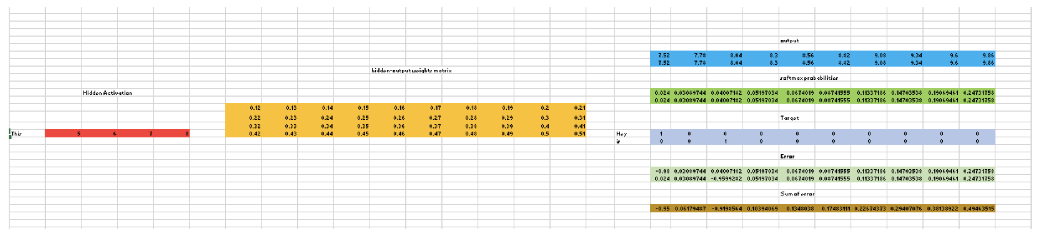
SkipGram
Input layer size – [1 X V]
Input hidden weight matrix size – [V X N]
Number of neurons in hidden layer – N
Hidden-Output weight matrix size – [N X V]
Output layer size – C [1 X V]
C - Context words = 2

Slide 71
SkipGram
1. The row in red is the hidden activation corresponding to the input one-hot encoded vector. It is basically corresponding row of input-hidden matrix copied.
2. The yellow matrix is the weight between the hidden layer and the output layer.
3. The blue matrix is obtained by the matrix multiplication of hidden activation and the hidden output weights. There will be two rows calculated for two target(context) words.
4. Each row of the blue matrix is converted into its softmax probabilities individually as shown in the green box.
5. The grey matrix contains the one hot encoded vectors of the two context words(target).
6. Error is calculated by substracting the first row of the grey matrix(target) from the first row of the green matrix(output) element-wise. This is repeated for the next row. Therefore, for n target context words, we will have n error vectors.
7. Element-wise sum is taken over all the error vectors to obtain a final error vector.
8. This error vector is propagated back to update the weights.

Slide 72
SkipGram
Advantages
Skip-gram model can capture two semantics for a single word. i.e it will have two vector representations of Apple. One for the company and other for the fruit.
http://bit.ly/wevi-online

Slide 73
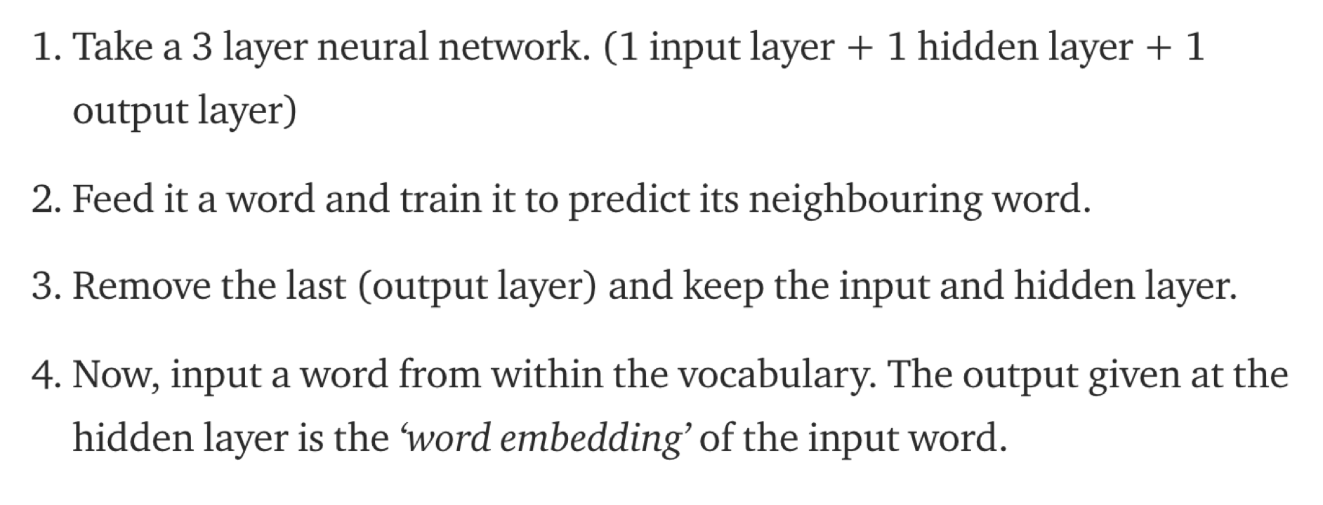
Word2Vec Steps Summary

Slide 74
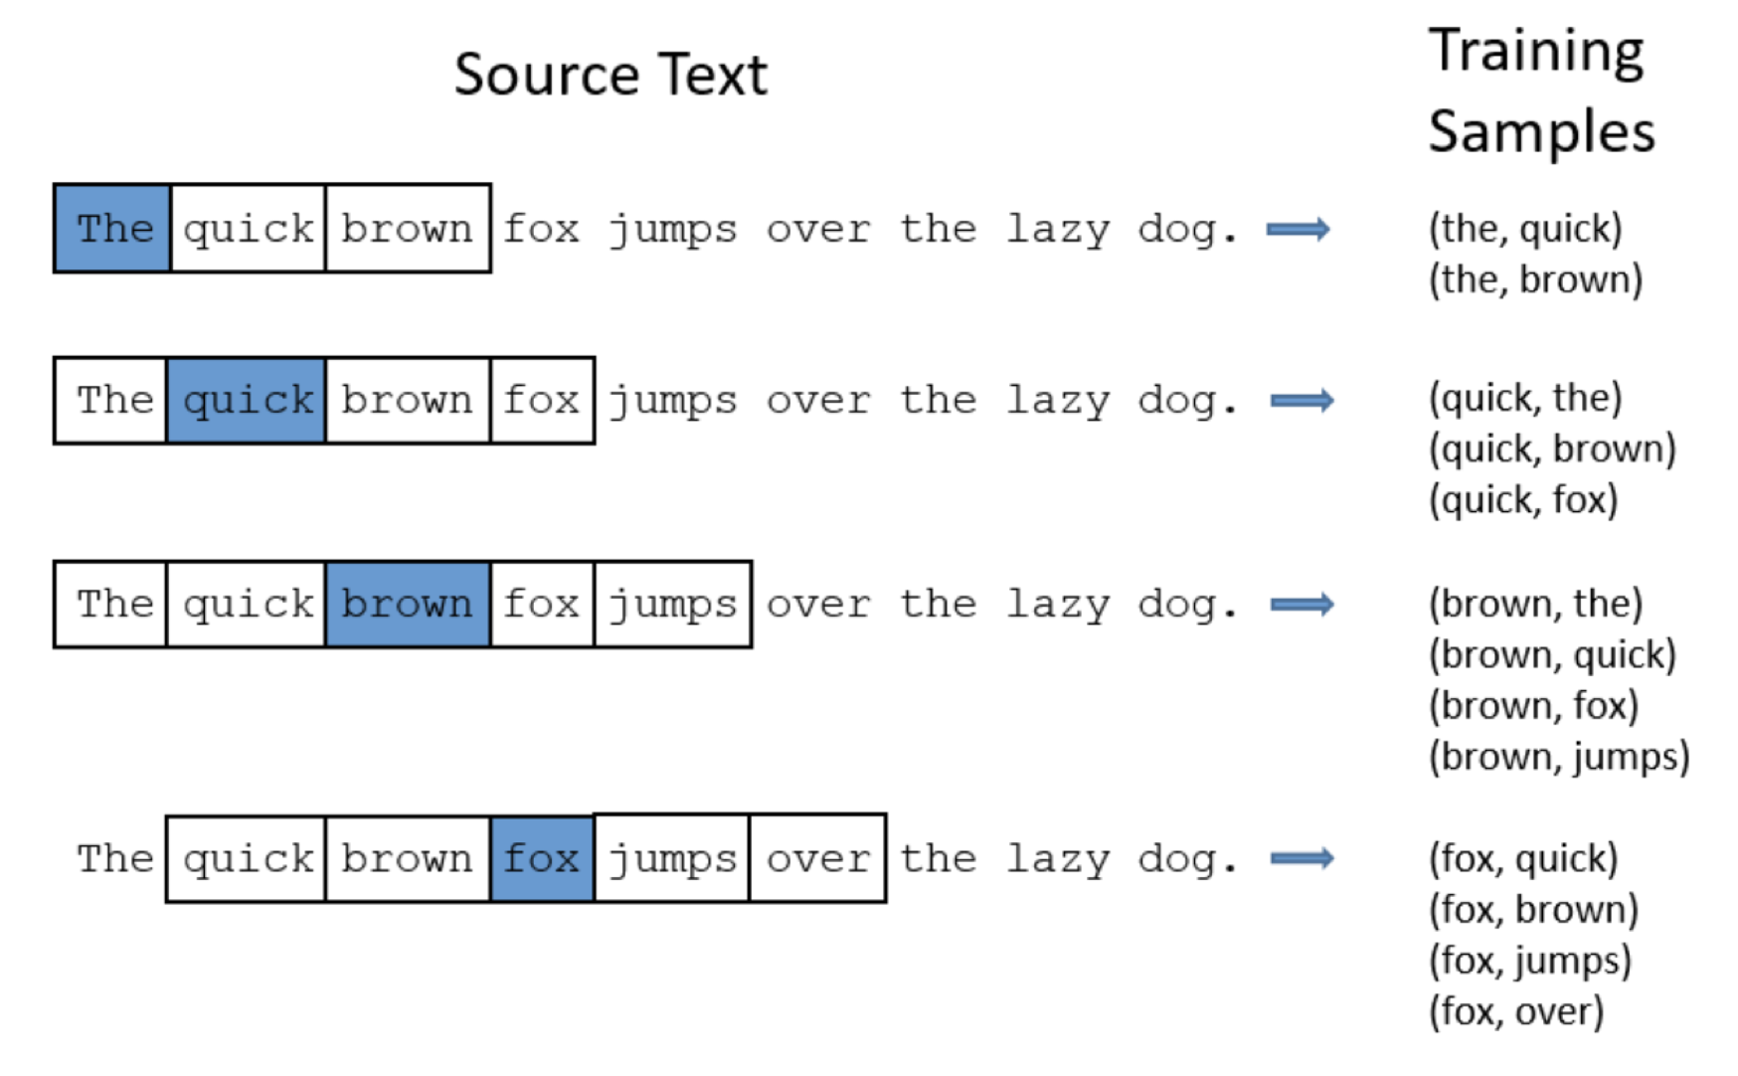

Slide 75
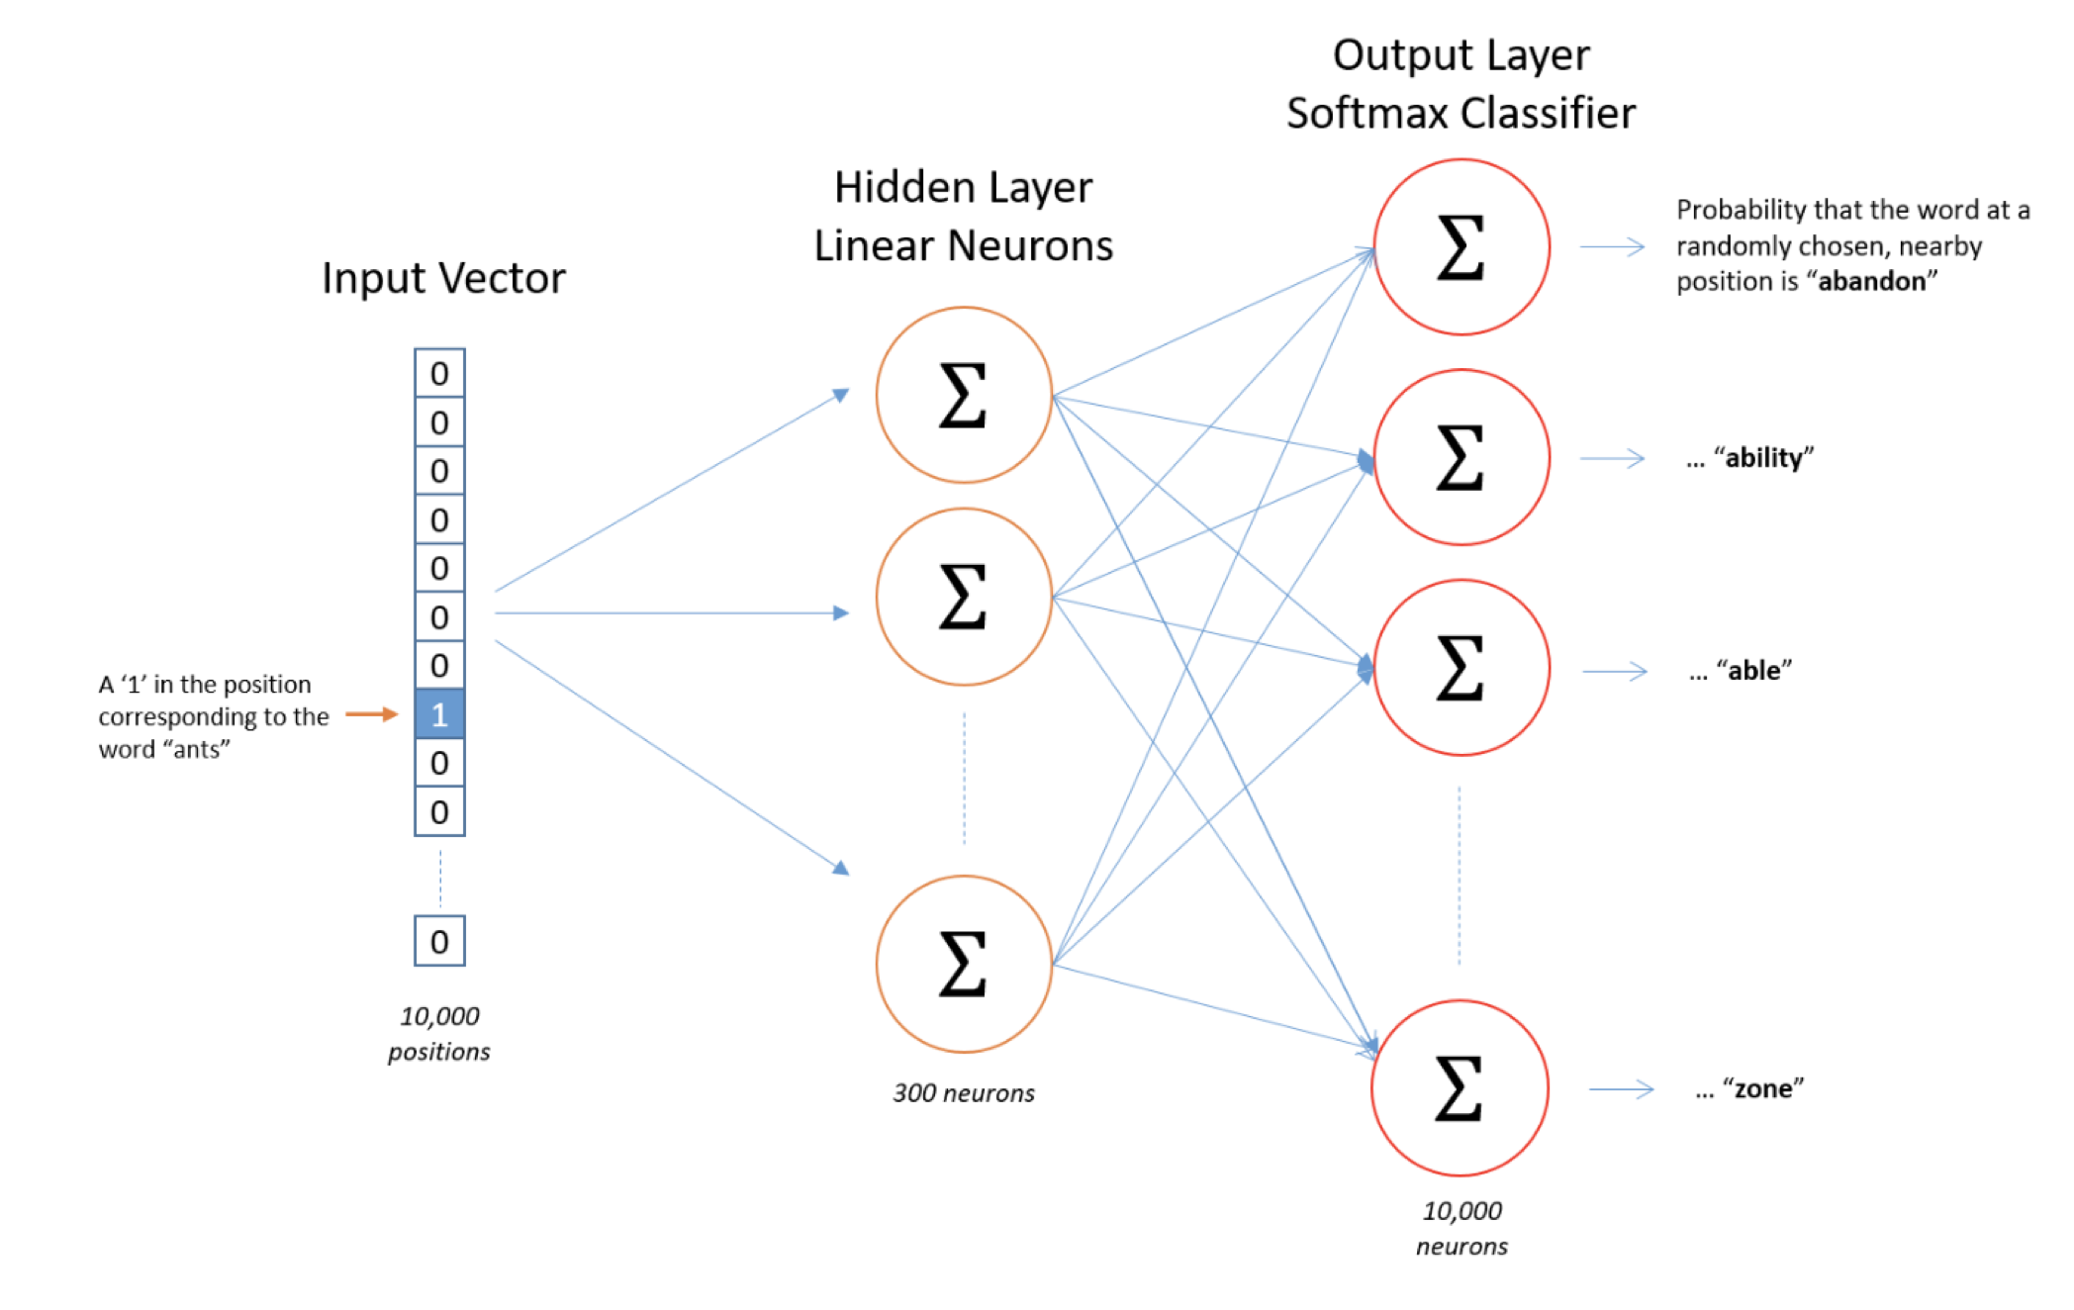

Slide 76
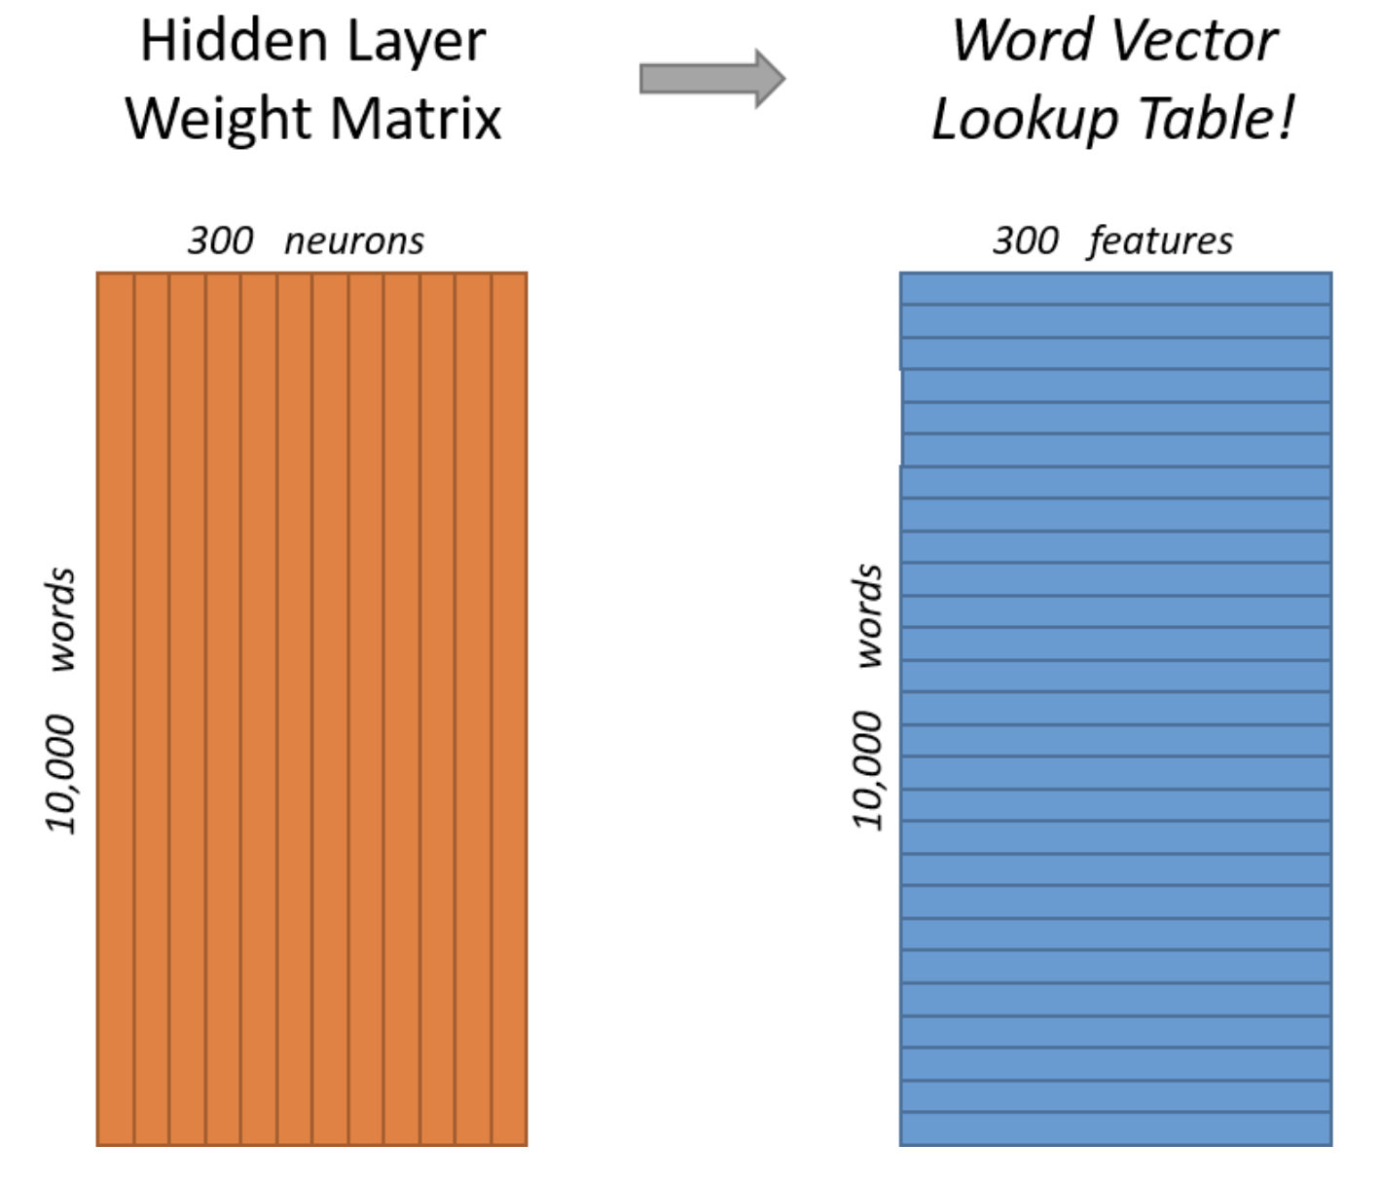

Slide 77
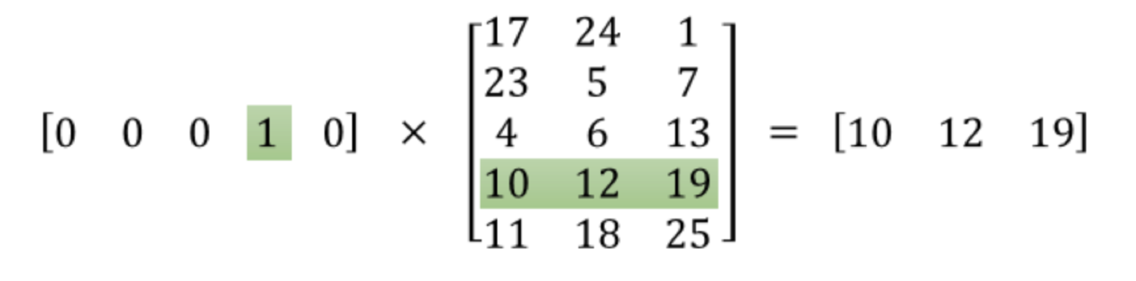
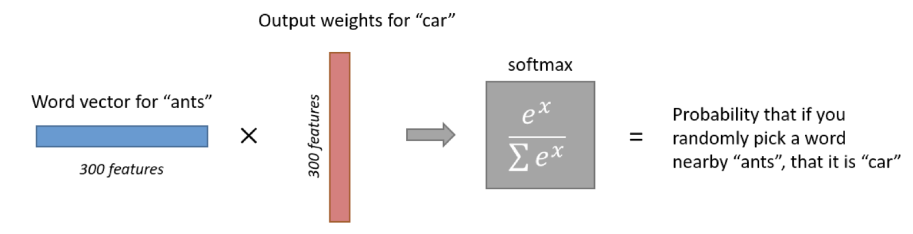

Slide 78
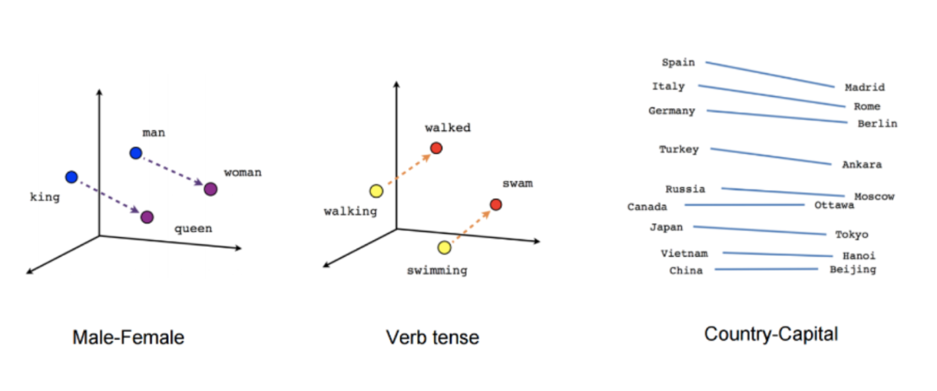
Word2Vec Relationships

Slide 79
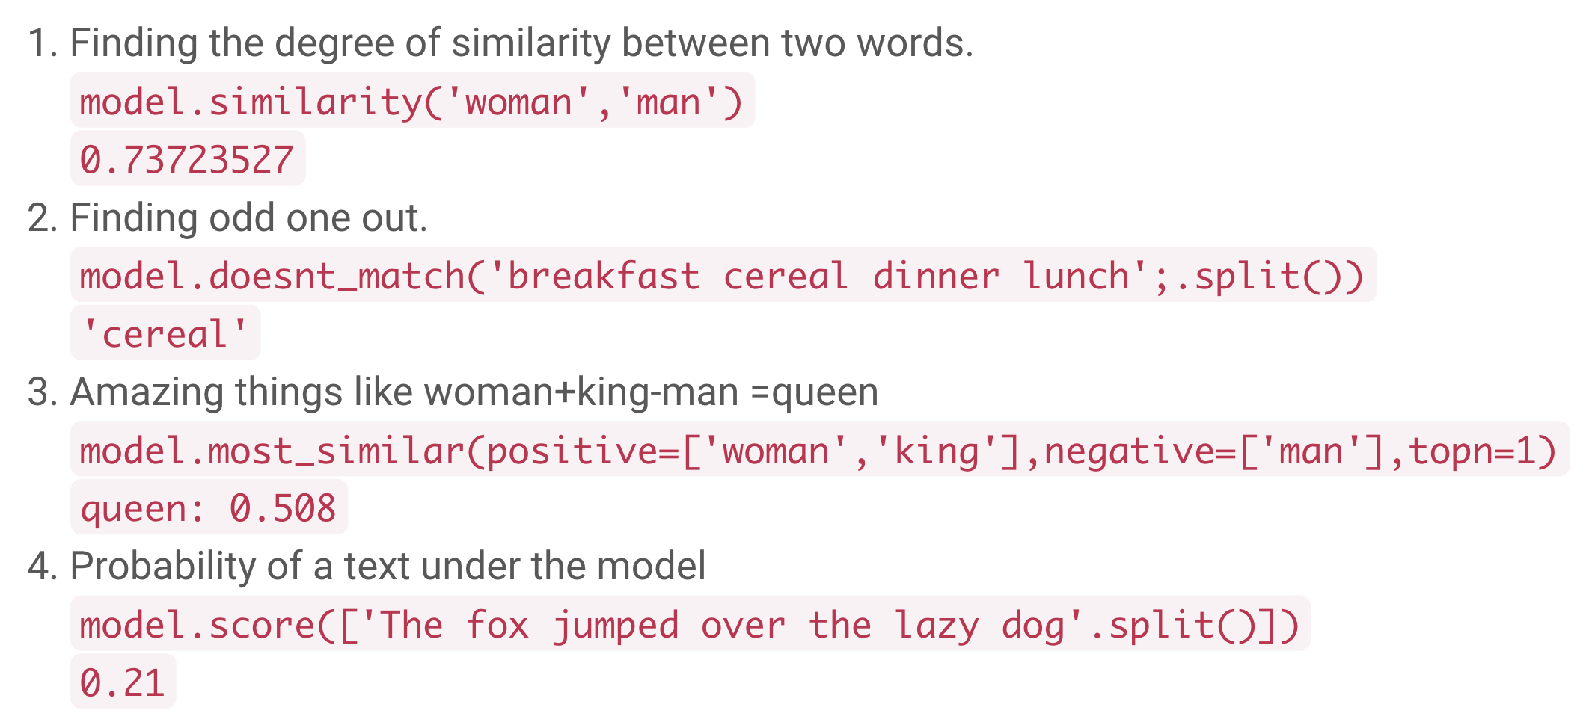
Usecases of Word Embeddings

Slide 80
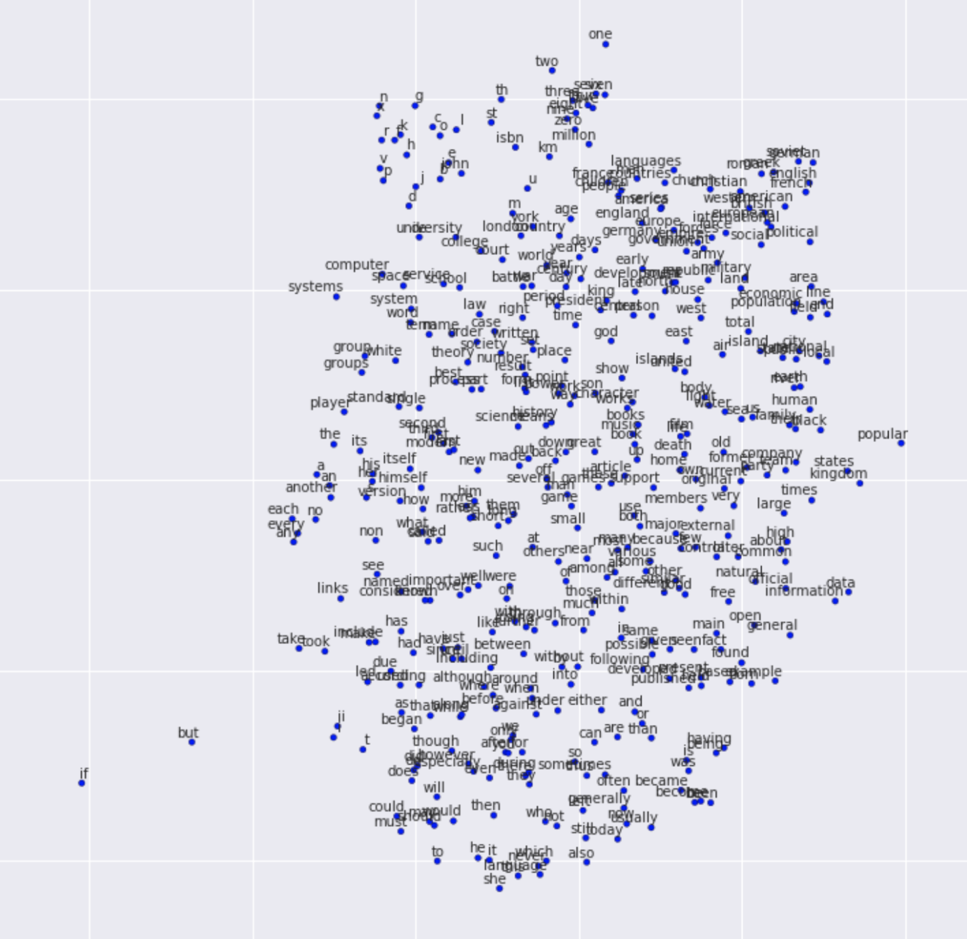
Visualization

Slide 81
GloVe

Slide 82
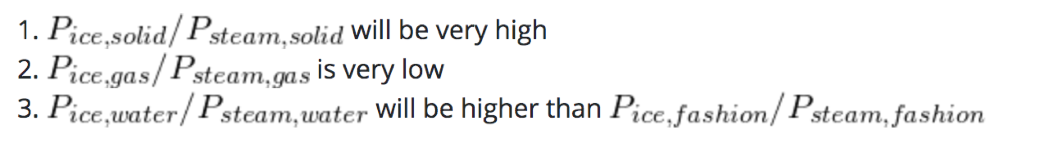
Glove
Idea: Ratios between probabilities of words appearing next to each other carry more information that individual probabilities

Slide 83
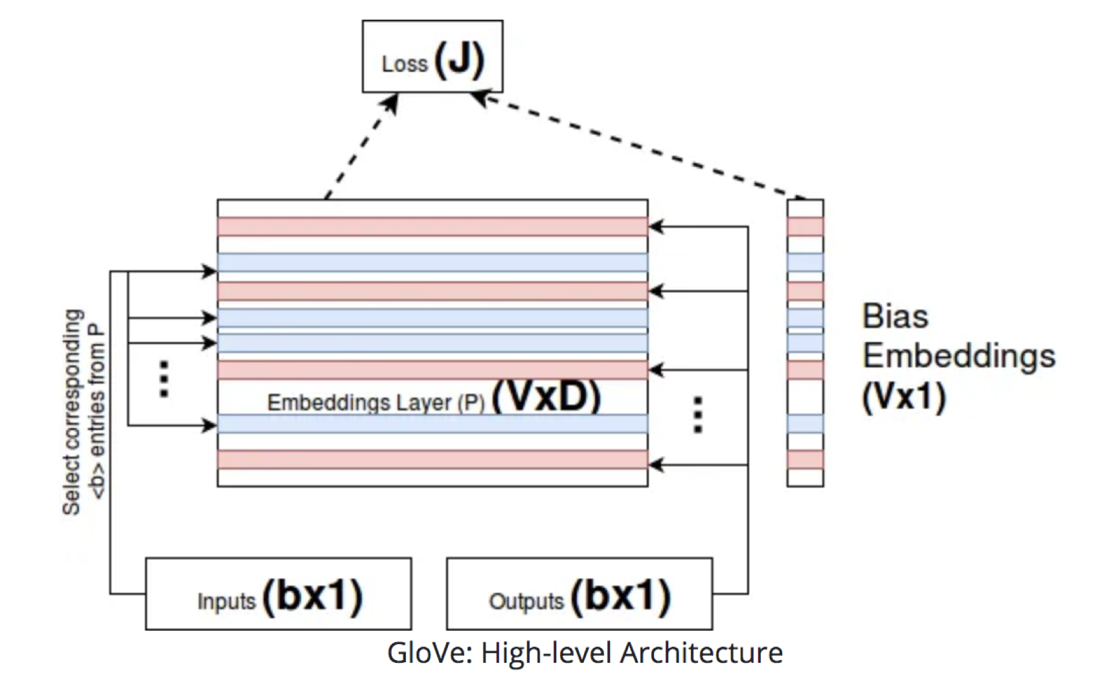
Glove

Slide 84
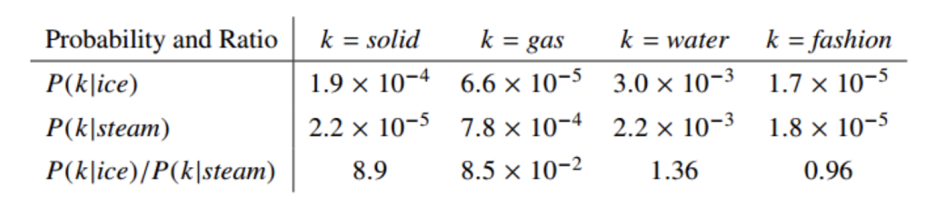
Glove

Slide 85
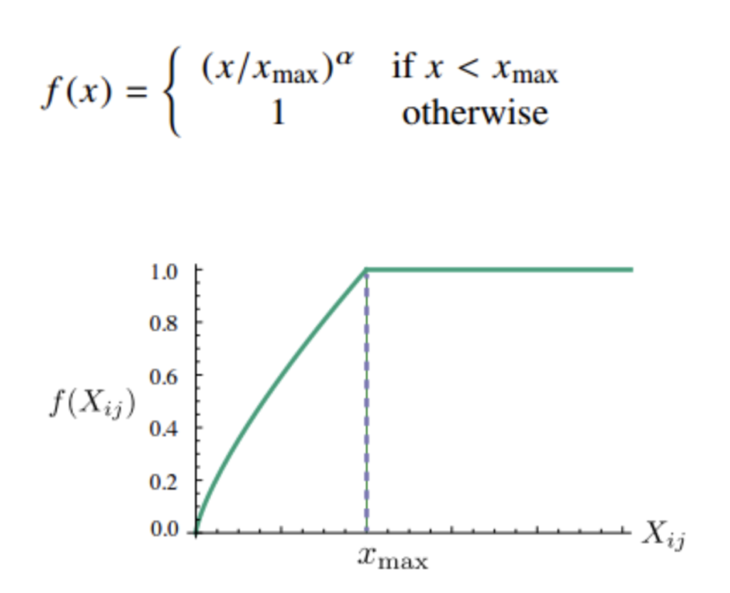
Glove

Slide 86

Glove Vs Word2Vec

Slide 87
Further Reading
Practical Natural Language Processing ​
Soumya Vajjala, Anuj Gupta, Harshit Surana, Bodhisattwa Majumder​

